Slide 1

Week 6 - Starting with Semantic Segmentation
Till now, we are done with the basic concepts of Deep Learning and Image Processing
Now, we will learn about -
Semantic Segmentation
Transpose Convolution
AI4LE Week 6. Session 3

Slide 2
What we will be doing in this week?
This week, you will learn how you can use Semantic Segmentation to drive your Lunar Rover for Exploration.
AI4LE Week 6. Session 3

Slide 3
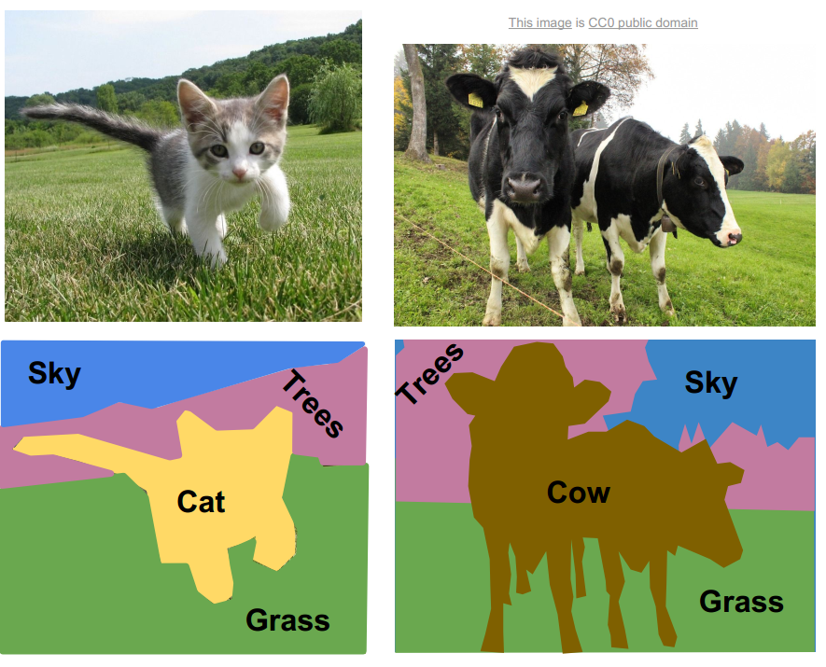
IMAGE SEGMENTATION
AI4LE Week 6. Session 3

Slide 4

For Autonomous Driving
AI4LE Week 6. Session 3

Slide 5
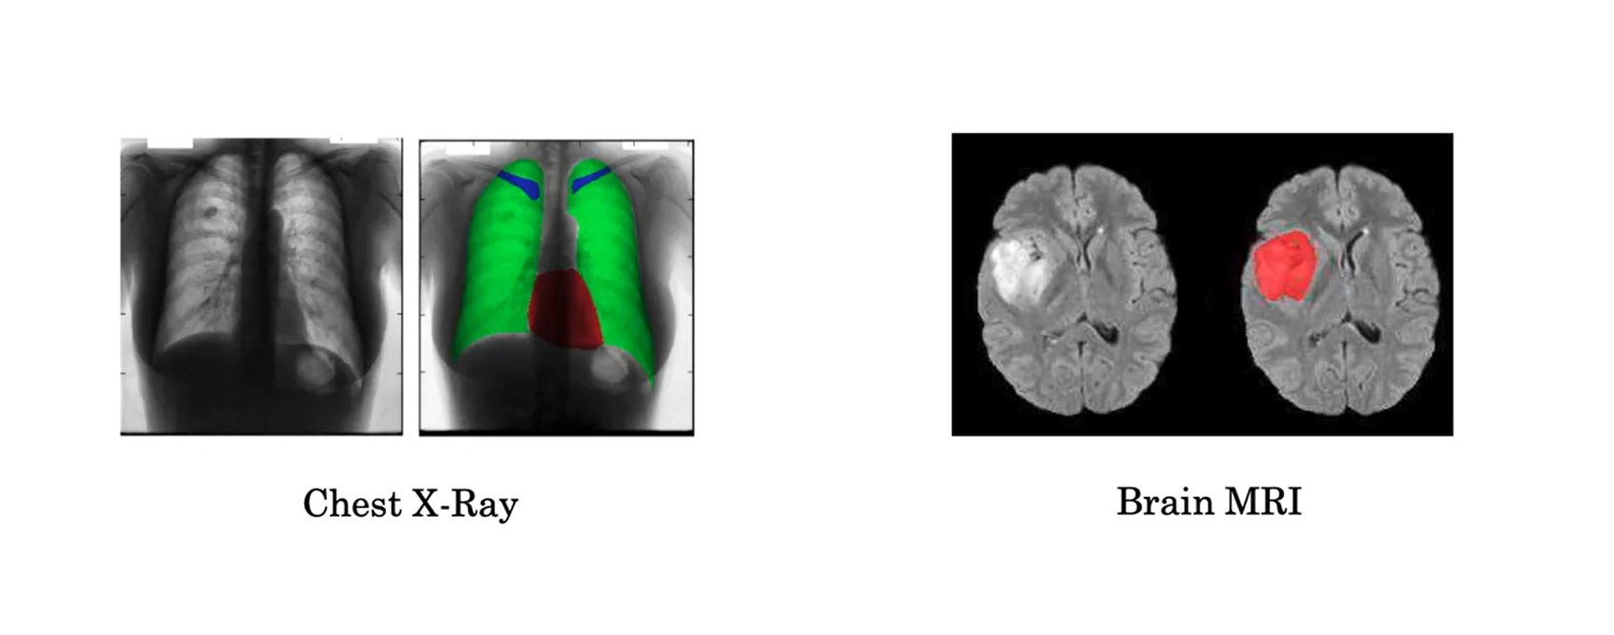
APPLICATIONS OF IMAGE SEGMENTATION
AI4LE Week 6. Session 3

Slide 6
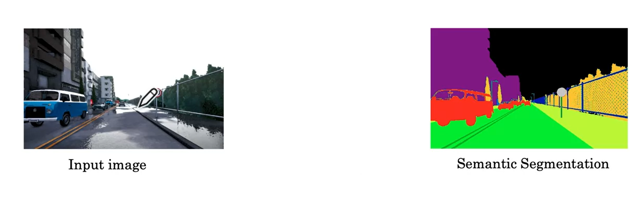
APPLICATIONS OF IMAGE SEGMENTATION
AI4LE Week 6. Session 3

Slide 7
TYPES OF SEGMENTATION
Semantic Image Segmentation
Instance Image Segmentation
Thresholding Image Segmentation
Edge Based Segmentation
Watershed Segmentation
AI4LE Week 6. Session 3

Slide 8
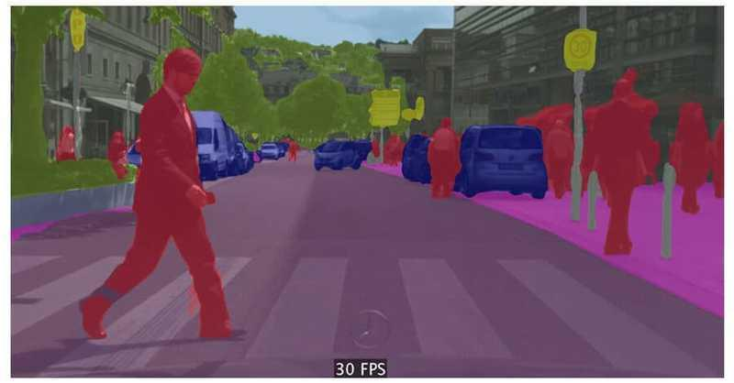
SEMANTIC SEGMENTATION
AI4LE Week 6. Session 3

Slide 9
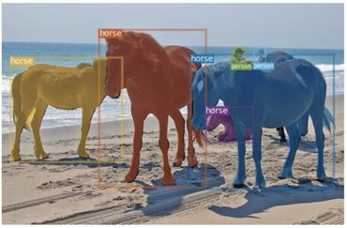
INSTANCE SEGMENTATION
AI4LE Week 6. Session 3

Slide 10
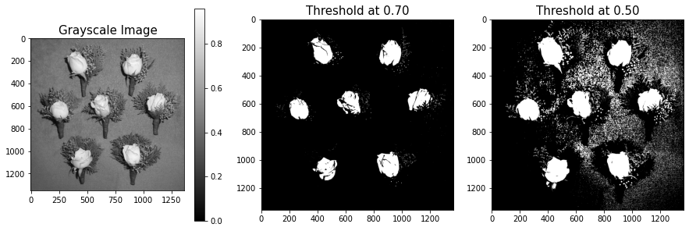
THRESHOLD SEGMENTATION
AI4LE Week 6. Session 3

Slide 11

EDGE BASED SEGMENTATION
AI4LE Week 6. Session 3

Slide 12
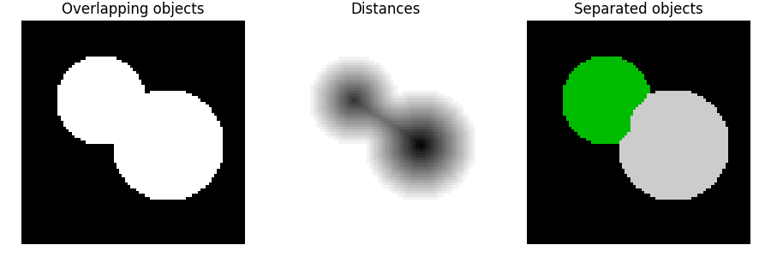
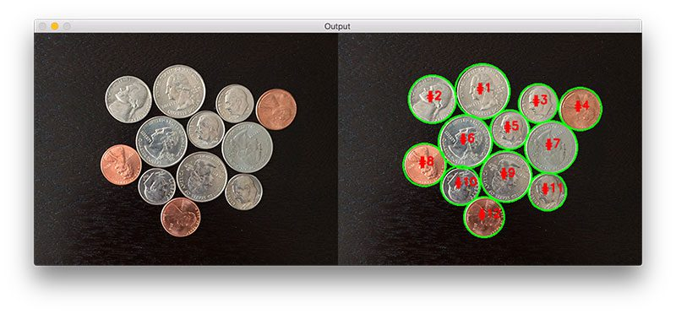
WATERSHED SEGMENTATION
AI4LE Week 6. Session 3

Slide 13
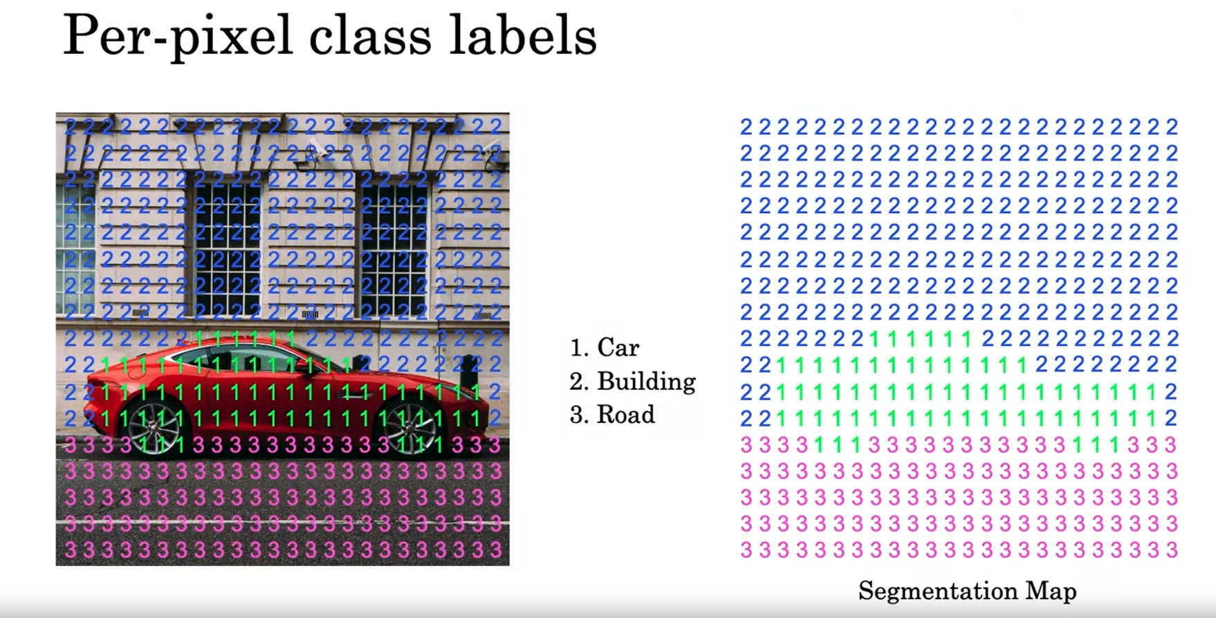
EXAMPLE SEMANTIC SEGMENTATION
AI4LE Week 6. Session 3

Slide 14
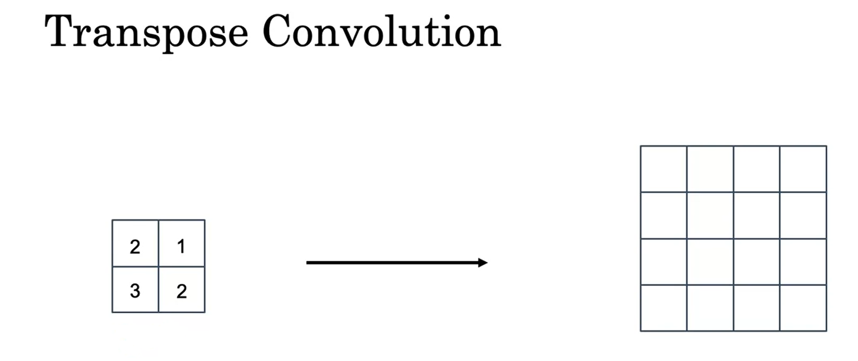
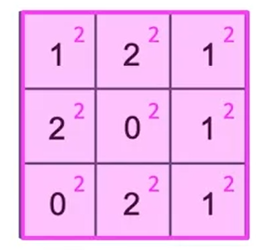
TRANSPOSE CONVOLUTION
AI4LE Week 6. Session 3

Slide 15
TRANSPOSE CONVOLUTION
Moving on to our Jupyter Notebook to understand more about Transpose Convolution

